Slide 1

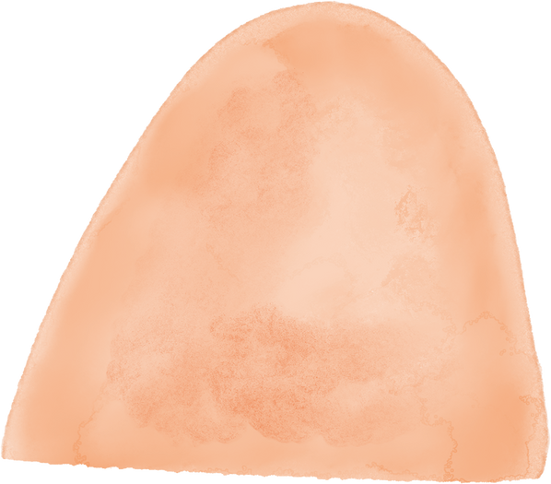









MUSC 4150 PROJECT
Stephanie Moreno

Slide 2

MY PROJECT
For my project, I wanted to combine both my goal of composing a musical score and the goal of creating a story one day, using some of the muscal techniques we learned throughout this course. I also needed to do a bit of research on the history of music in Mexico, specifically in Guanajuato, during the 1700s. So I wanted to create a storyboard for a character I had created in middle school and add a soundtrack.
In reality, this project was a lot more difficult than I had anticipated. However, I was able to try something I had never done before and for someone with not as strong of a musical background, I am pretty proud of what I have gotten done.

Slide 3
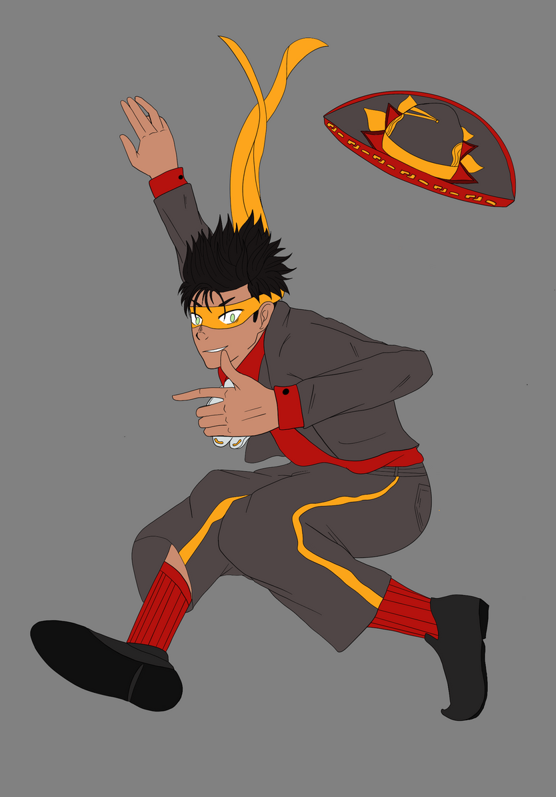
BACKSTORY & CULTURE
Before I present my project, I would like to give some background on the story that surrounds my character and the storyboard. My main character’s name is Aeneas Rodriguez-Castellano and he is from Guanajuato, Mexico. He comes from a family of witches that make deals with the devil in exchange for black magic. He essentially walks away from ths life because it isn’t a life he wants to live. However, he could never really walk away from that forever and people associate him with his family. As a result, he becomes very ostracized from society and is lonely. Regardless of this, he never harbors hate toward people because he knows what hate can do to the people around him. He gains his powers after helping a woman being harassed by a Spanish soldier, and becomes a vigilante. Conflict arises when he realizes someone is using black magic against him and is confronted by the Spanish Catholic Church for being a vigilante.

Slide 4
WHAT I’LL BE SHARING
ARTWORK
SOUNDTRACK
STORYBOARD & SCRIPT
I have prepared character profiles for the two main characters, showcasing their personalities and physical attributes
I have prepared a soundtrack for my storyboard and a two piece end credit scene. I will also mention 2 songs that would absolutly need to be included
I have prepared a very rough storyboard for a trailer of this work and a very detailed script.

Slide 5
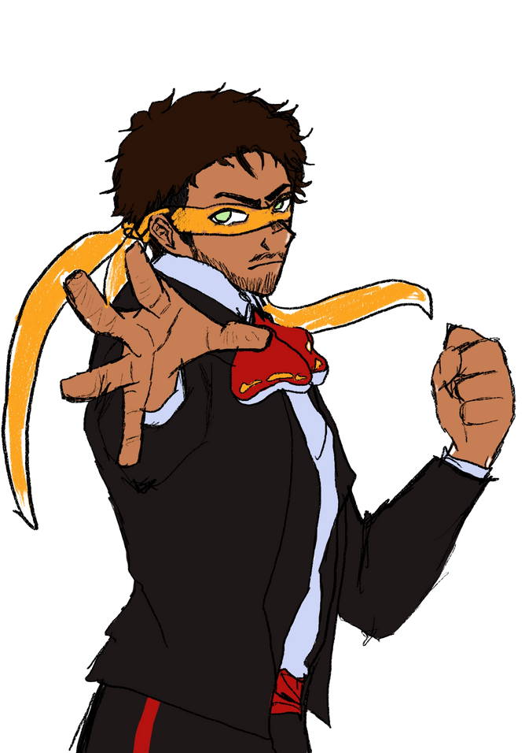
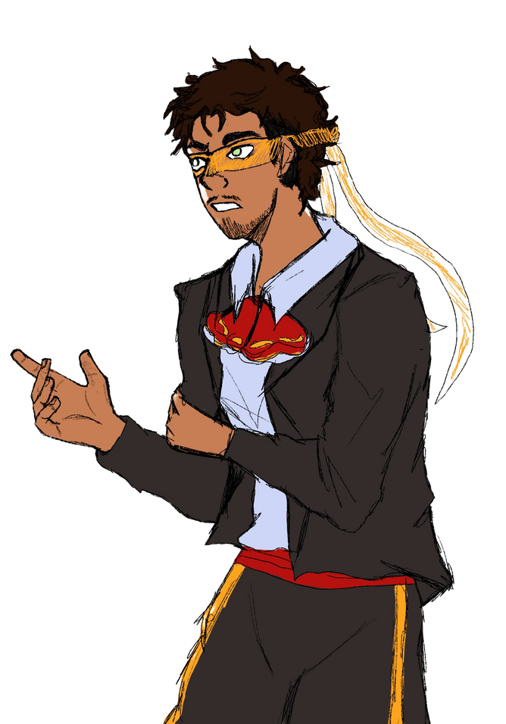
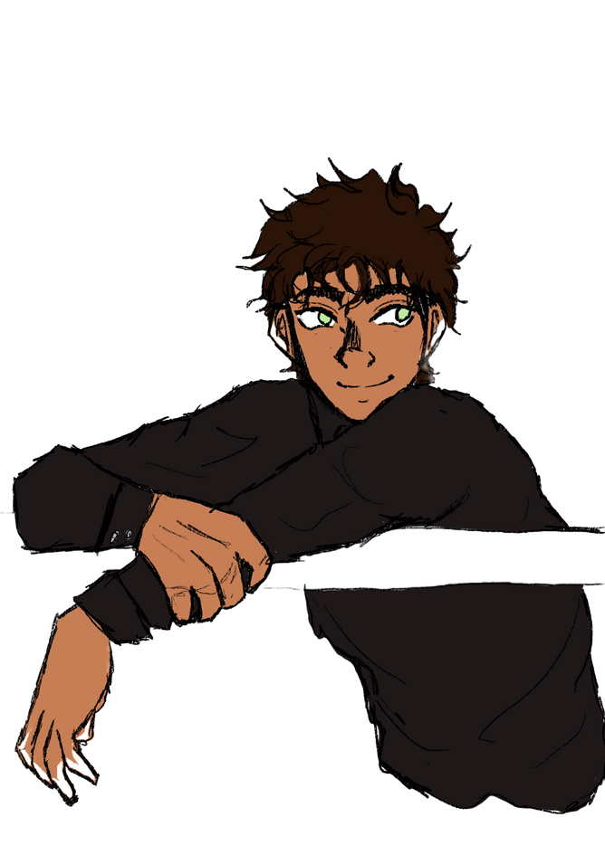
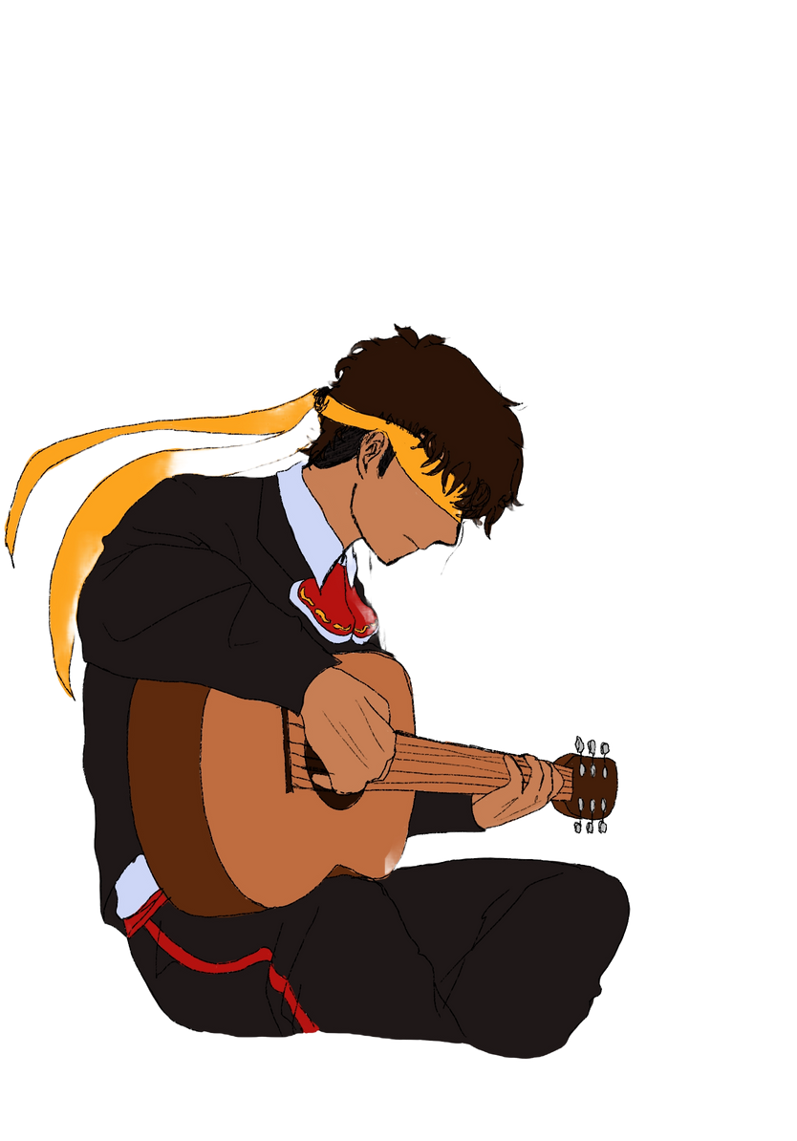
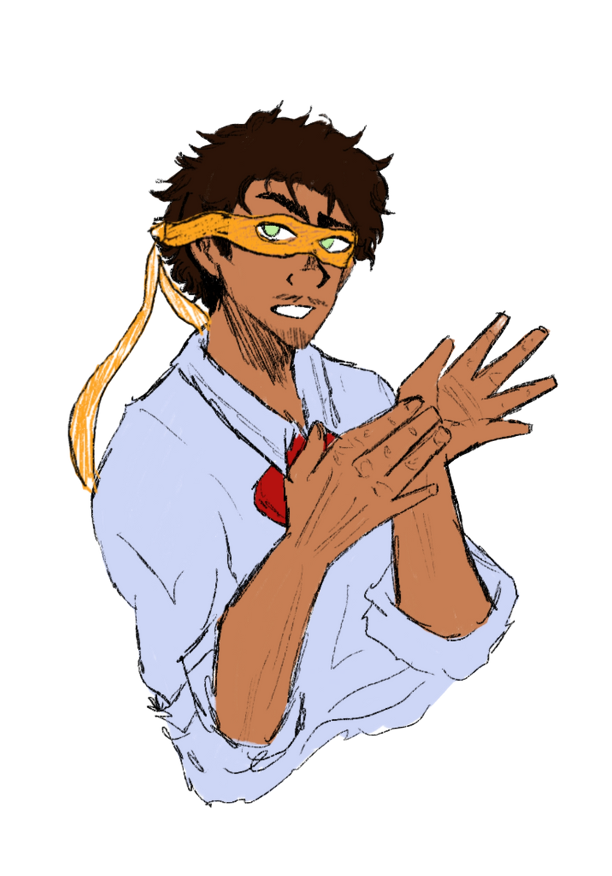
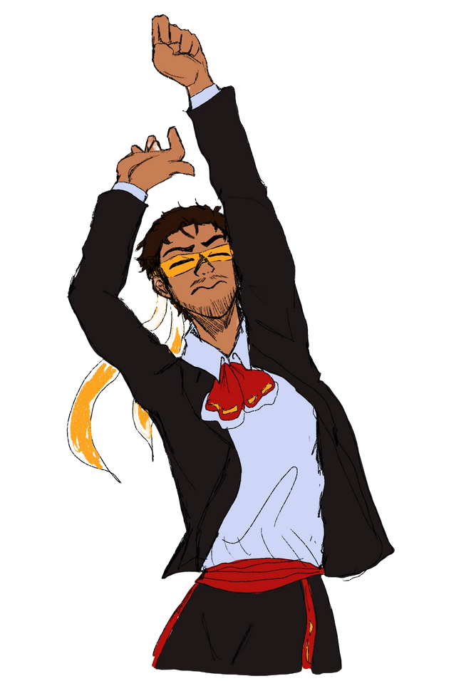
MEET THE CHARACTERS
AENEAS RODRIGUEZ-CASTELLANO

Slide 6
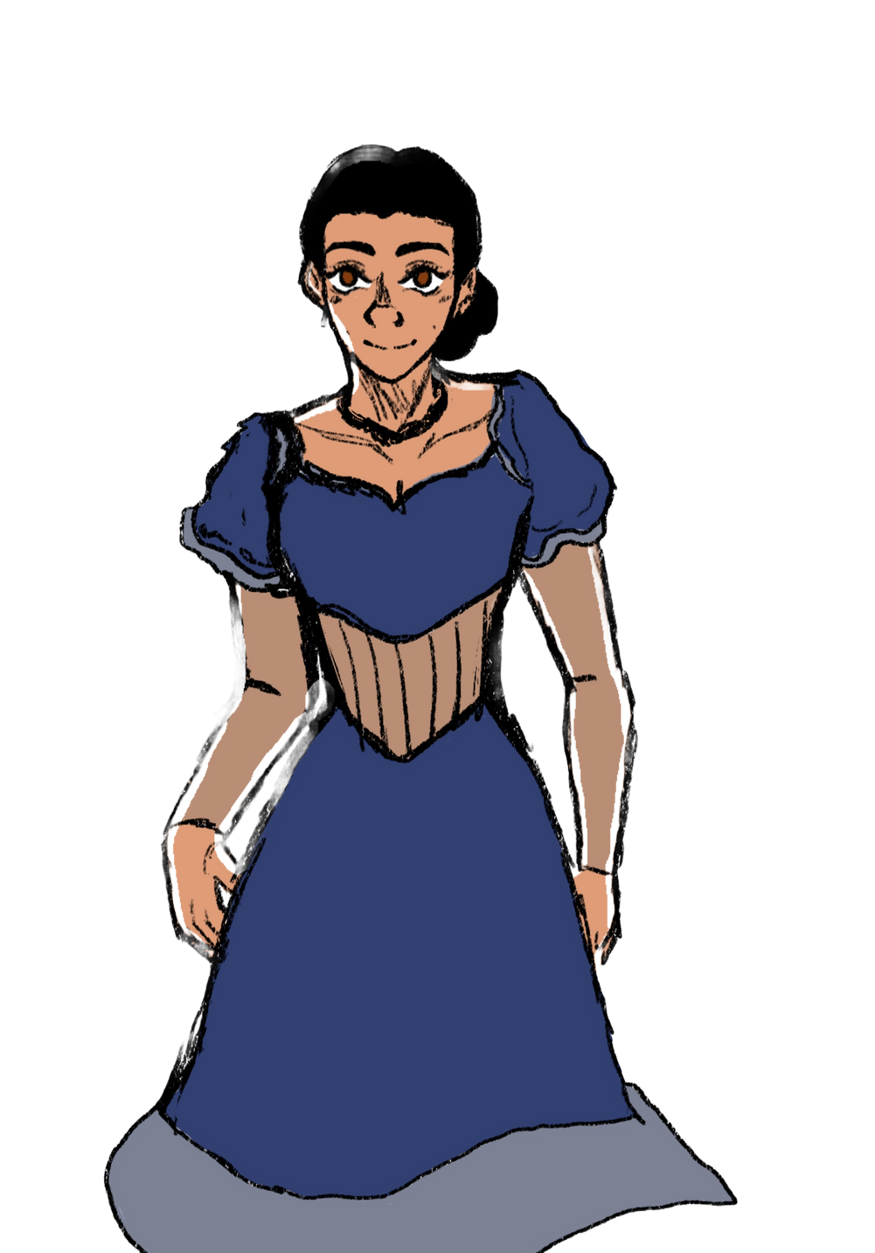
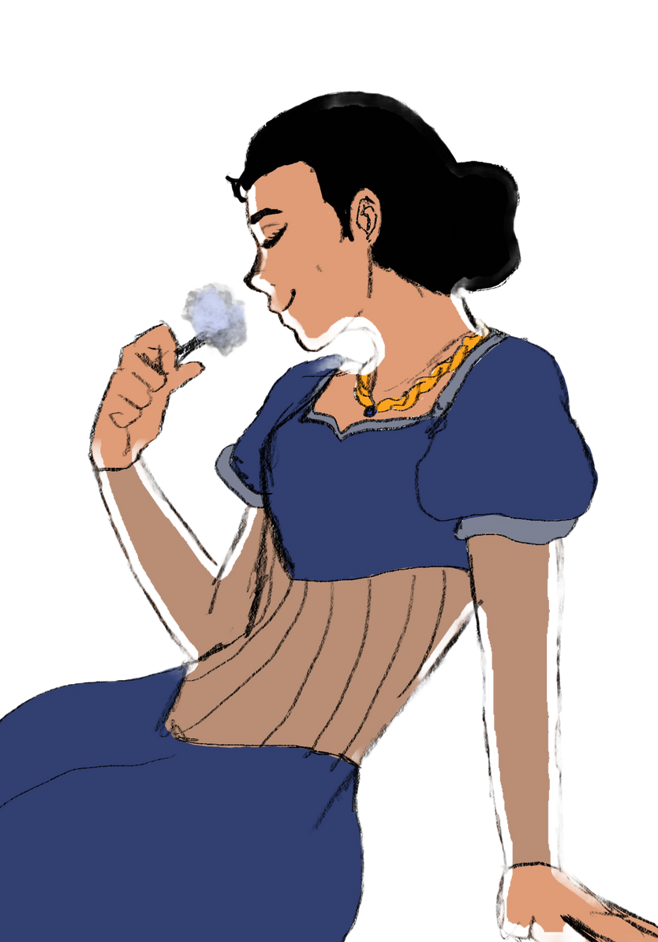
MEET THE CHARACTERS
VALENTINA MONTEZ-GUTIERREZ

Slide 7

A BIT OF MUSIC HISTORY IN MEXICO
1521
17th Century
In 1521, Mexico was conolozed by Spanish Conquistadors and in 1552 Guanajuato was found by Captain Juan de Jaso and from 1552-1559ish it was colonized to exploit its rich minerals
Mexican Son was one of the first dated forms of Music in Mexico. Interestingly, Mexican Son in the 17th century was influenced by Baroque music and utilized many Baroque techniques.

Slide 8
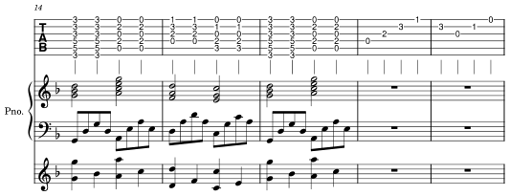
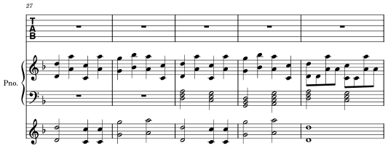
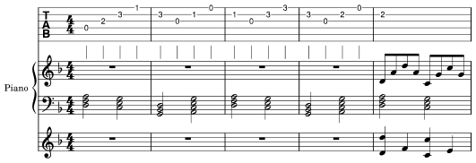
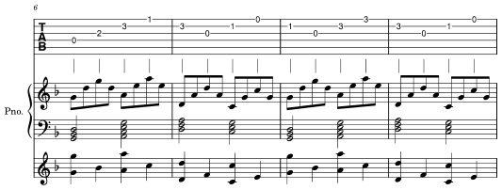
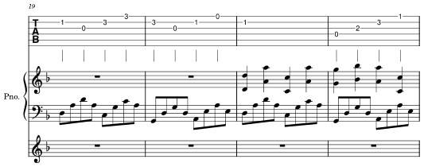
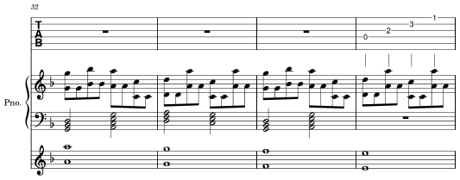
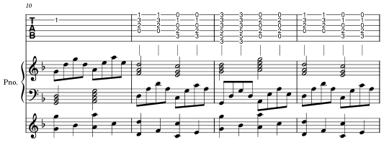
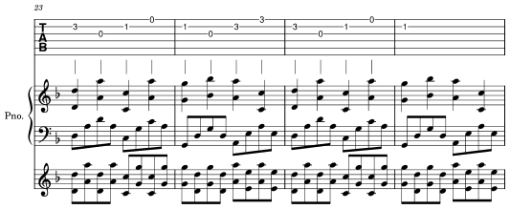
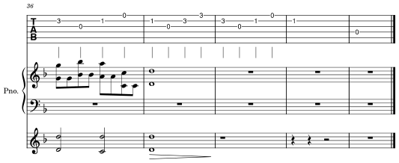
MUSICAL SCORES

Slide 9
MUSIC I WOULD WANT TO ADD
YO SOY EL AVENTURERO- PEDRO FERNANDEZ
LA PEOPLE- PESO PLUMA

Slide 10
STORYBOARD

Slide 11
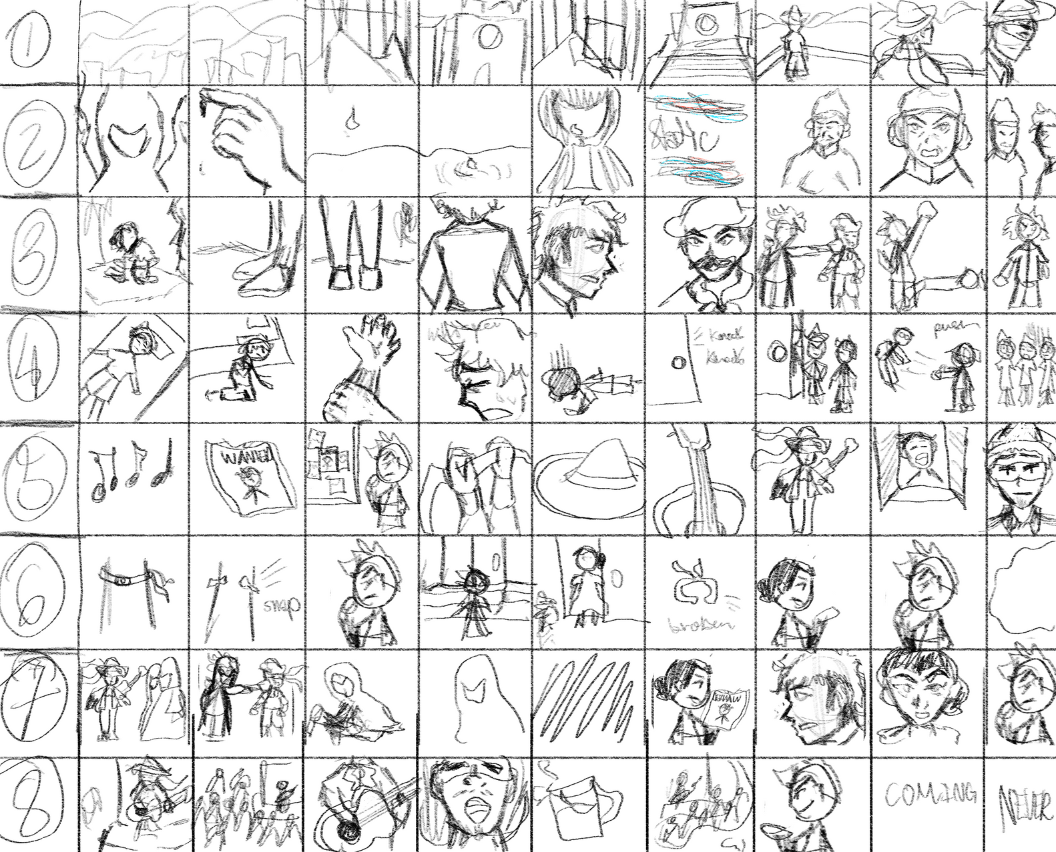
STORYBOARD

Slide 12
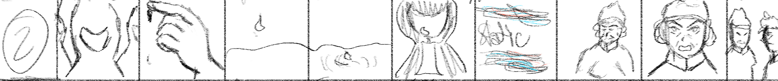
SCENE 2
PERO A VECES…[PAUSE]
[Cut to scene with his family performing witchcraft]
las cosas que hacen nuestros seres queridos, nos define aún más
[cut to the pope talking to him]
Pope: Es simple, dime con quién andas, y yo te diré quien eres
[dramatic cut]
[Silence]

Slide 13
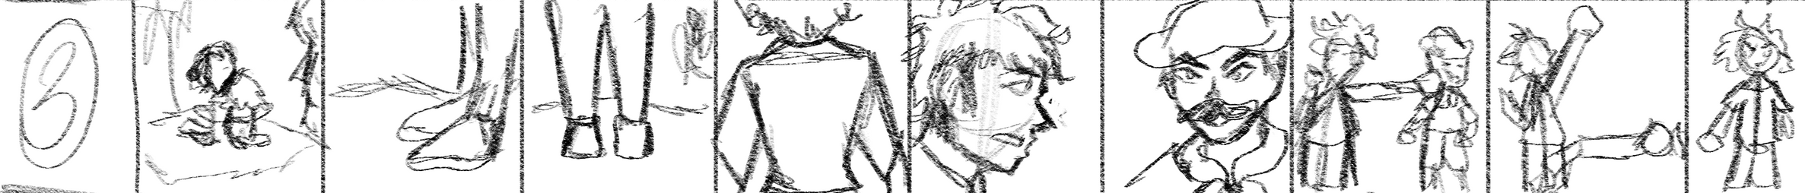
SCENE 3
[WOMAN CRYING AND BEING HARASSED IN FRONT OF HER CHILD BY SPANISH OFFICER]
[Footsteps of Aeneas are heard]
[slow pan up to him from behind, about to confront the culprit]
[scene focuses on his face, no costume, this is where his story starts]
Aeneas: No creo que le estes poniendo buen ejemplo al niño
[Spanish officer looks at him with anger]
[woman cries]
[child looks up to him in hope]
Spanish Officer [sneering]: Y vos quien es, eh? Su padre?
[Aeneas sighs and glares]
[cut to shots of dramatic fight scene]
[dragged away from woman, uppercut, more fighting]
[Aeneas wins and is standing over the unconscious officer]
{He is bad shape and nearly died, and out of breath}
[Woman is hugging her child and shaking]
[She looks at him and cries]
[Child hugs him and thanks him for saving his mother]
[Aeneas leaves, walking away]

Slide 14
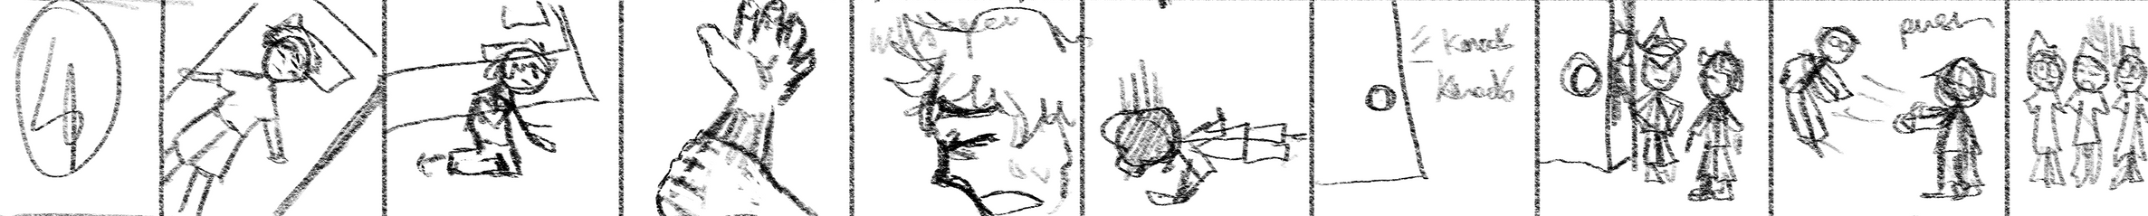
SCENE 4
[CUT TO LATER THAT NIGHT]
{AENEAS, LYING IN HIS BED, COVERED IN SWEAT AND BARELY BREATHING AFTER TREATING HIS WOUNDS]
[STRANGE WHISPERS/CHANTS FILLS THE ROOM]
{AENEAS FALLS TO THE GROUND AND CLUTCHES HIS WRIST, WHERE HIS BRACELET STARTS TO BURN}
[THE WHISPERS STOP AND HE PASSES OUT]
{AENEAS WAKES UP TO KNOCKING ON HIS DOOR}
[SPANISH OFFICIALS ARE AT HIS DOOR AND WANT TO QUESTION HIM]
OFFICIALS: VOS ERES EL VAGABUNDO DE ANOCHE?
{AENEAS NOTICES THAT THEY ARE ARMED AND REACHES FOR THE SWORD BEHIND HIS DOOR}
[ONE OF THE OFFICIALS NOTICES AND ATTEMPTS TO STRIKE FIRST]
[AENEAS MOVES OUT OF THE WAY AND IS STRONG ENOUGH TO PUSH HIM ALL THE WAY ACROSS THE ALLEY]
AENEAS: [IN DISBELIEF] AY CARAY

Slide 15
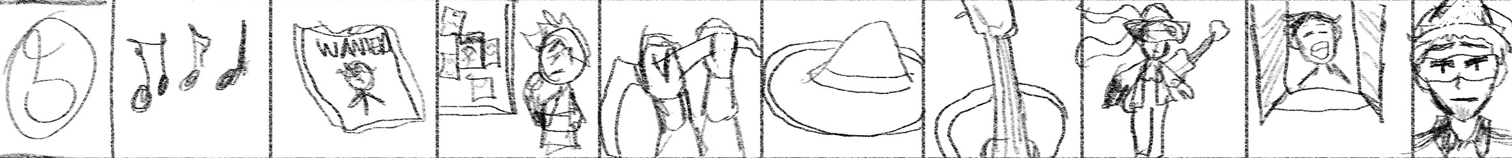
SCENE 5
[MUSIC STARTS]
[FIGHT SCENES AND PUBLIC RECOGNITION STARTS UP, WANTED POSTERS OF MYSTERIOUS PERSON, NO PICTURE]
[AENEAS REALIZES HE WILL NEED A DISGUISE AFTER SEEING HIS POSTER]
{AENEAS GETS HIS MARIACHI SUIT AND PUTS ON A MASK}
[CUT TO BEGINNING OF A FIGHT SCENE]
ONLOOKER/BYSTANDER: LE VAS HACER SERENATA O QUE PUES?
[LAUGHTER]
[AENEAS LOOKS AT THEM LIKE REALLY -_-]

Slide 16
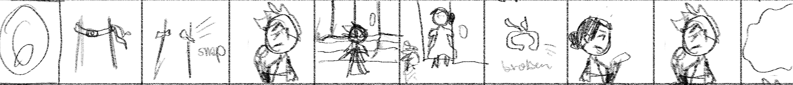
SCENE 6
[MUSIC START TO BUILD UP DRAMATICALLY]
[AENEAS REALIZES HIS BRACELET HAS SNAPPED]
{HE LOOKS DOWN AT HIS WRIST IN WORRY AND LOOKS TO THE SIDE, THINKING}
[HE APPEARS AT THE DOORSTEP OF A HOUSE]
{HE SIGHS AND KNOCKS ON THE DOOR}
[VALENTINA OPENS THE DOOR]
[AENEAS, LOOKS AT HER AND PULLS OUT THE BRACELET]
AENEAS: DICEN POR ALLI QUE USTED ME PUEDE AYUDAR CON ALGO ASÍ
[SHE LOOKS DOWN AT THE BRACELET AND GASPS]
[SHE LOOKS AROUND AND DRAGS HIM INSIDE]
VALENTINA: ALGUIEN TE ESTÁ HECHIZANDO
{AENEAS, WHISPERING AND HOLDING HIS HEAD}
AENEAS:[QUIETLY] CHINGADA MADRE…
[VALENTINA SIGHS AND LOOKS DEFEATED]
VALENTINA: ALGO ME DICE QUE TIENES IDEA DE QUIÉN ES, ¿NO?
[AENEAS LOOKS DISTURBED]
[CUT TO SCENE OF THEM AFTER CHURCH]
AENEAS: VENGO DE UNA FAMILIA DE BRUJAS NEGRAS
[SCENES IN THE BACKGROUND]
AENEAS: PERO NO ES UNA VIDA QUE QUERÍA PARA MI MISMO,Y ME FUI [PAUSE]
AENEAS: PERO SU MARCA ME SIGUE AUN
VALENTINA: PERO SI YA NO HABLAS CON ELLOS, NO HAY POR QUÉ PREOCUPARSE, ¿NO?

Slide 17
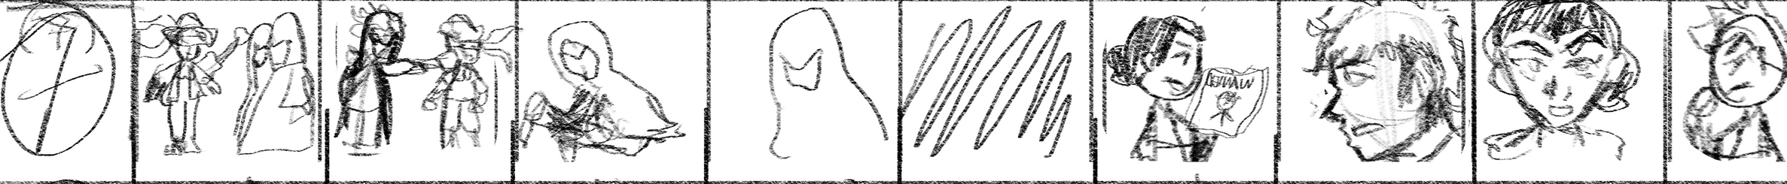
SCENE 7
[DRAMATIC MUSIC CUE]
[SHOTS OF FIGHTING WITH HIS FAMILY]
[SHOTS OF HIM BEING PINNED DOWN AND FOUGHT]
[MOTHER WHISPERS]
FAMILY MEMBER(MOM): NO PUEDES ESCAPARTE DE ESTA VIDA, MIJO
[MORE MUSIC]
[DRAMATIC BUILD UP]
[RANDOM WIND DOWN]
[CUT TO BAR SCENE WITH VALENTINA]
[HOLDING WANTED POSTER AND NEWS PAPER]
VALENTINA: ¿HAS VISTO QUE TE ESTÁN PONIENDO APODOS?
[AENEAS RAISES A BROW]
[VALENTINA LEANS IN]
VALENTINA: MIRA, EL SERENATERO, EL ROMPE GUITARRAS, EL BIGOTÓN, AH, HASTA EL ZORRO TE ESTÁN DICIENDO
[AENEAS MAKING FACES DURING ALL OF THIS]
AENEAS [EXCLAIMING]: EL ZORRO? ¿QUÉ QUIEREN DECIR?
VALENTINA[LAUGHING]: A VER, ENTONCES CÓMO QUIERES QUE TE DIGAN?
[AENEAS, THINKING]

Slide 18
SCENE 8
[CUTS SCENES OF MORE FIGHTS]
[BUILD UP TO YO SOY EL AVENTURERO]
[IN THE PUB SINGING]
AENEAS [SINGING]:¡AVENTURERO YO SOY!
[CUT BACK TO PUB SCENE W/VALENTINA]
AENEAS[SHRUGGING]: BUENO PUES, EL SERENATERO SI ME SUENA
[DRAMATIC BOOM]
COMING NEVER

Slide 19
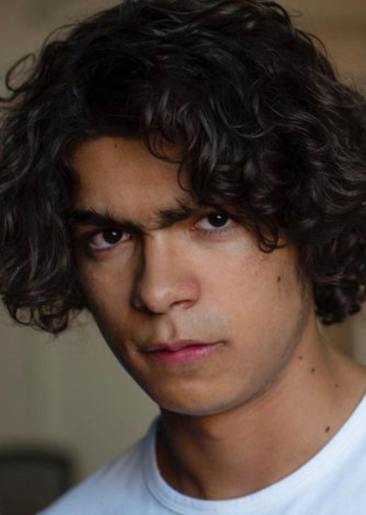
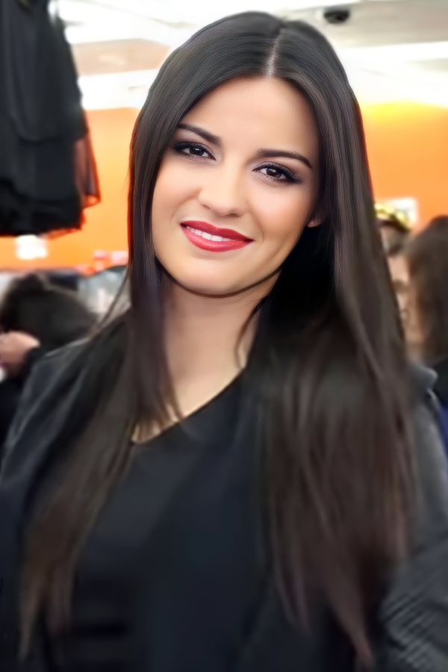
WHO I WOULD CAST...
IÑAKI GODOY
MAITE PERRONI

Slide 20
LESSONS LEARNED
I learned that I need to manage my time a bit better if I wanted to actually get this done one day. I also realized that I tended to get off track a lot with this project. I had a hard time remebering that this project was for a Musoc History class and not just a fun side project. I also learned that there’s a lot of things that I would actually have to put more time and effort into learning. For example, I need to learn proper anatomy when it comes to drawing, improve on defining my art style, I need to revisit music theory, learn the guitar, learn how to use more tech software, etc.

Slide 21
PROJECT CONCLUSION
I had a lot of fun working on this project. I know that if I hadn’t taken this class, I probably wouldn’t have even tried to work on something like this. I know that I’va always wanted to do something like this, but actually doing it made me love it. I would love to pick this up, polish it, learn more about music, learn more about composing, and learn how to play the guitar in order to bring this to life. Whether it be an actual movie, a comic, or an animation, I want to be able to share this work with the world one day

Slide 22
THANK YOU VERY MUCH!

